Slide 1

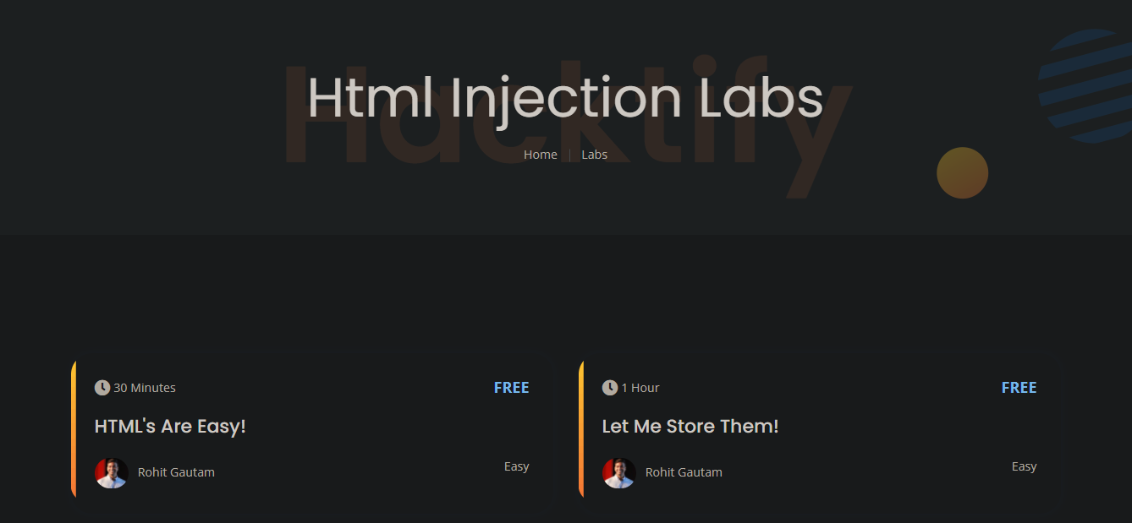

This week I learned about
Creating reports for penetration testing and bug bounty
HTML Injection attacks
Clickjacking
Clickjacking
Virtually Testing Foundation
HTML Injection

